Slide 1
CSE7302- University Project
Review-2
STUDENT INNOVATION:SWADESHI FOR ATMANIRBHAR BHARAT-
SMART AUTOMATION
Batch Number:IST_27
Under the Supervision of,
Dr. Afroz Pasha, PhD, M.Tech., B.E.
Assistant Professor - Senior Scale
School of Computer Science and Engineering Presidency University
20221IST0055 | DARSHAN GOWDA S
20221IST0069 | CHETHAN C
20221IST0112 | CHIRAG GOWDA SV
Roll Number | Student Name
Name of the Program: Information Science And Technology
Name of the HoD: DR. PALLAVI R
Name of the Program Project Coordinator: MS. BENITHA CHRISTINAL J
Name of the School Project Coordinators: Dr. Sampath A K

Slide 2
Analysis of Problem Statement
Equipment data is complex and includes time-series sensor values and categorical logs.
Predicting failure requires disciplined preprocessing such as feature scaling, encoding, and splitting.
Model choice impacts accuracy; ensemble methods often perform best for tabular maintenance data.
Success is measured via metrics like accuracy, precision, recall, and ROC-AUC.

Slide 3
Objectives
Collect and preprocess industrial equipment data including telemetry, maintenance logs, error history, and failure records.
Perform Exploratory Data Analysis (EDA) to understand key patterns and features impacting failures.
Train and evaluate ML models to accurately predict potential equipment failures.
Deploy a prediction pipeline to infer future failures from new data.
Provide insights that help reduce downtime and optimize maintenance scheduling.

Slide 4
Literature Review
1. AI-Powered Predictive Maintenance System for Industrial Equipment (2025)
Proposes a hybrid AI system using sensor data, anomaly detection, and machine learning models.
The system predicts equipment failures early and improves maintenance planning.
Shows reduction in downtime and maintenance cost, but real-time industrial deployment and labelled data availability remain challenges.
2. Machinery Diagnostics and Prognostics using Condition-Based Maintenance (2006)
Explains the concept of condition-based maintenance using data collection, processing, and decision-making.
Highlights diagnostic techniques to detect faults and prognostic models to predict future failures.
Shows that multi-sensor data improves accuracy but integration and real-time implementation remain difficult.
3. Machine Learning-Based Predictive Maintenance of Industrial Machines (2023)
Discusses how ML algorithms like Random Forest, SVM, and Decision Trees predict machine failures.
Demonstrates improved equipment reliability and reduced downtime compared to traditional maintenance.
Requires large amounts of historical data and proper feature selection for effective prediction.

Slide 5
Literature Review
4. Comparing Deep Learning and Fourier Series Models for Equipment Failure Prediction (2025)
Compares mathematical signal analysis with deep learning (LSTM) for predicting failures.
Results show LSTM gives better prediction accuracy and captures complex machine behaviour.
However, deep learning requires high data volume and complex system integration.
5. Comparison of Deep Learning Models for Predictive Maintenance (2025)
Evaluates CNN, LSTM, and hybrid CNN-LSTM models using industrial sensor data.
Hybrid CNN-LSTM achieves highest accuracy and reliability in failure prediction.
Highlights challenges in data quality, computational cost, and deployment in real industries.
6. Condition Monitoring and Predictive Maintenance: Hybrid and Signal Processing Review (2025)
Reviews classical ML, deep learning, and hybrid physics-based predictive maintenance approaches.
Shows advanced signal processing and multi-modal sensor fusion improve fault detection.
Major issues include lack of labelled data, model interpretability, and adapting to changing machine conditions.

Slide 6
Literature Review
7. IoT-Based Predictive Maintenance in Industrial Machinery (2025)
Uses IoT sensors, cloud computing, and ML algorithms for real-time monitoring.
Demonstrates improved machine reliability and reduced maintenance cost.
Challenges include data security, storage, and scalability of IoT systems.
8. Predictive Maintenance using Machine Learning in Industrial IoT (2024)
Explains how IoT generates continuous data streams that enable real-time failure prediction.
Uses deep learning and adaptive algorithms to improve maintenance decisions.
Managing large data streams and maintaining real-time response remain key difficulties.
9. Predictive Maintenance Methods for Electrical Machines using ML and Sensor Data (2025)
Reviews ML and deep learning techniques for monitoring electrical equipment like motors and transformers.
Shows multi-sensor fusion improves fault detection accuracy and reliability.
Identifies challenges such as data quality, model overfitting, and system complexity.

Slide 7
Literature Survey
Title | Existing Research (Authors) | Ref / Year | Methodology | Evaluation Metrics | Open Research Issues
AI-Powered Predictive Maintenance System for Industrial Equipment | Abdul Aziz, Sowmyashree P | 2025 | Hybrid AI PdM using sensor data, Autoencoder for anomaly detection, Gradient Boosting and LSTM for failure prediction, Hybrid health index generation | Precision, Recall, F1-score, Remaining Useful Life (RUL) MAE, downtime reduction, false alarm rate | Limited labelled failure data, heterogeneous sensor data integration, real-time deployment challenges, lack of explainable AI
A Review on Machinery Diagnostics and Prognostics Implementing Condition-Based Maintenance | Andrew K.S. Jardine, Daming Lin, Dragan Banjevic | 2006 | Condition-Based Maintenance framework involving data acquisition, signal processing, diagnostics and prognostics techniques | Reliability improvement, maintenance cost reduction, fault detection accuracy | Multi-sensor data fusion complexity, lack of standardized frameworks, real-time analytics limitations
Comparing Deep Learning and Fourier Series Models for Equipment Failure Prediction | Houria Abouloifa, Mohamed Bahaj | 2025 | Comparative predictive maintenance using Fourier series signal model and LSTM deep learning time-series prediction | MAE, MSE, RMSE, statistical significance testing, confidence interval validation | Lack of real industrial datasets, computational cost of DL models, integration difficulties

Slide 8
Literature Survey
Title | Existing Research (Authors) | Ref / Year | Methodology | Evaluation Metrics
Comparison of Deep Learning Models for Predictive Maintenance in Industrial Manufacturing Systems | Wenjun Li, Ting Li | 2025 | Deep learning PdM using CNN, LSTM and CNN-LSTM hybrid architectures for failure prediction and RUL estimation | Accuracy, F1-score, model robustness, generalization performance, feature importance analysis
Condition Monitoring and Predictive Maintenance in Industrial Equipment: NLP-Assisted Review | Jose Garcia, Luis Rios-Colque, Alvaro Peña, Luis Rojas | 2025 | NLP-based systematic literature review including ML, DL, signal processing methods (FFT, Wavelets, CEEMDAN) and hybrid physics-data models | Fault detection accuracy, RUL accuracy, deployment feasibility, energy efficiency improvement
IoT Based Predictive Maintenance in Industrial Machinery | Himmat Singh | 2025 | IoT PdM architecture using sensor networks, cloud analytics, ML-based failure prediction and real-time monitoring dashboard | Reliability improvement, maintenance cost reduction, breakdown reduction, equipment lifespan improvement

Slide 9
Literature Survey
Title | Existing Research (Authors) | Ref / Year | Methodology | Evaluation Metrics
Machine Learning-Based Predictive Maintenance of Industrial Machines | Chaitali Patil, Sanika Jadhav, Asmeeta Bardiya, Ankita Davande, Mahee Raverkar | 2023 | ML PdM system using Random Forest, SVM and Decision Tree, sensor monitoring, edge-cloud processing, alert generation | Prediction accuracy, feature selection performance, downtime reduction
Predictive Maintenance using Machine Learning in Industrial IoT | Jesu Narkarunai Arasu Malaiyappan, Gowrisankar Krishnamoorthy, Suhas Jangoan | 2024 | ML & DL techniques in IIoT including ANN models, deep learning prediction, real-time stream processing, cyber-physical system integration | Prediction latency, system reliability, real-time processing efficiency
A Review of Predictive Maintenance Methods for Electrical Machines Using ML Algorithms and Sensor Data | Nandni Sharma, Cheshtha Chauhan, Anju Dwivedi, Sanchita Dass | 2025 | ML-based PdM using Motor Current Signature Analysis, multi-sensor fusion, SVM, Random Forest, CNN, LSTM models | Accuracy, Precision, Recall, multi-modal sensor performance

Slide 10
Base Papers
Li, W., Li, T. Comparison of deep learning models for predictive maintenance in industrial manufacturing systems using sensor data. Sci Rep 15, 23545 (2025). https://doi.org/10.1038/s41598-025-08515-z

Slide 11
Methodology and Drawbacks
Data Acquisition & Preprocessing
  Three public datasets: rotary machinery, milling machine, hydraulic system
  Data cleaning, normalization, feature extraction (time/frequency domains)
Model Construction
  CNN (1D/2D convolutional networks for spatial features)
  LSTM (for temporal sequence modeling)
  CNN-LSTM hybrid (combined architecture)
Training & Evaluation
  70/15/15 train/validation/test split
  Adam optimizer, hyperparameter tuning
  Metrics: Accuracy, Precision, Recall, F1-score, MAE, RMSE
  Ablation studies and feature importance analysis
Experimental Setup:
High-performance computing (NVIDIA Tesla V100)
TensorFlow 2.4 implementation
Five independent runs for statistical significance

Slide 12
Methodology and Drawbacks
Interpretability Issues
                Black-box model behavior hinders trust in industrial settings
                Difficult to explain predictions to maintenance engineers
Data Dependency
      Requires extensive labeled failure data for training
  Performance sensitive to data quality and completeness
Deployment Challenges
  Complex integration with existing maintenance systems
  High computational requirements for training
Generalization Concerns
  Models optimized for specific datasets/equipment types
  Limited testing on diverse real-world environments

Slide 13
Research Gap
1.Interpretability Deficit in Deep Learning Models
Problem:
  Current CNN/LSTM models function as "black boxes" with limited explanation capability
  Maintenance engineers cannot understand why a failure is predicted, reducing trust
  Regulatory and safety-critical industries require explainable decisions
2. Legacy System Integration Challenge
Problem:
  Industrial environments have 20+ year old SCADA, PLC, and CMMS systems
  Proprietary protocols and data silos prevent seamless AI model integration
  Real-time inference requires bridging between modern Python/TensorFlow and legacy industrial networks

Slide 14
Proposed Solution
Advanced Deep Learning Architectures:
Transformer-Based Models (e.g., Time Series Transformers)
  Self-attention mechanisms naturally provide feature importance
  Can visualize attention weights across time and sensor channels
Explainable AI (XAI) Integrated Models:
  SHAP-LSTM Hybrids (SHapley Additive exPlanations)
  Grad-CAM CNNs for visualizing critical sensor regions
  Bayesian Neural Networks providing uncertainty quantification
Neuro-Symbolic AI Systems:
  Combine deep learning with knowledge graphs
  Map sensor patterns to known failure modes from maintenance logs
  Generate human-readable explanations: "Bearing failure predicted due to increasing vibration at 2X RPM frequency"

Slide 15
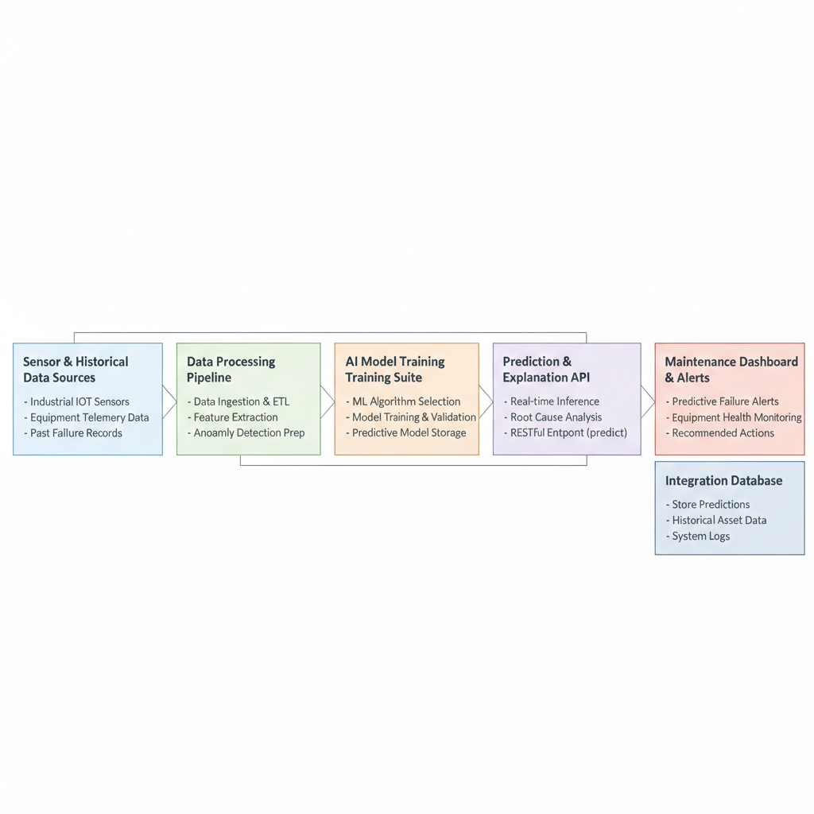
Architecture Diagram

Slide 16
Github Link
https://github.com/darshan99009/IST_27-Capstone_Project

Slide 17
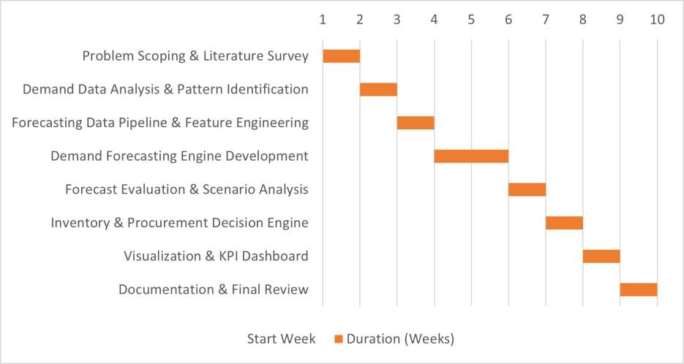
Timeline of the Project (Gantt Chart)

Slide 18
References (IEEE Paper format)
[1] AI-Powered Predictive Maintenance System for Industrial Equipment: Reducing Downtime and Costs Through Sensor-Based Analytics, 2025.
[2] A. K. S. Jardine, D. Lin, and D. Banjevic, “A Review on Machinery Diagnostics and Prognostics Implementing Condition-Based Maintenance,” Mechanical Systems and Signal Processing, 2006.
[3] H. Abouloifa and M. Bahaj, “Comparing Deep Learning and Fourier Series Models for Equipment Failure Prediction in Predictive Industrial Maintenance 4.0,” Scientific Reports, 2025.
[4] W. Li and T. Li, “Comparison of Deep Learning Models for Predictive Maintenance in Industrial Manufacturing Systems Using Sensor Data,” Scientific Reports, 2025.

Slide 19
References (IEEE Paper format)
[5] J. Garcia, L. Rios-Colque, A. Peña, and L. Rojas, “Condition Monitoring and Predictive Maintenance in Industrial Equipment: An NLP-Assisted Review of Signal Processing, Hybrid Models, and Implementation Challenges,”
[6] H. Singh, “IoT-Based Predictive Maintenance in Industrial Machinery,” International Journal for Modern Trends in Science and Technology, 2025.
[7] C. R. Patil, S. K. Jadhav, A. L. Bardiya, A. P. Davande, and M. P. Raverkar, “Machine Learning-Based Predictive Maintenance of Industrial Machines,” International Journal of Computer Trends and Technology, 2023.
[8] J. N. A. Malaiyappan, G. Krishnamoorthy, and S. Jangoan, “Predictive Maintenance Using Machine Learning in Industrial IoT,” International Journal of Innovative Science and Research Technology, 2024.
[9] A Review of Predictive Maintenance Methods for Electrical Machines Using Machine Learning Algorithms and Sensor Data, 2025.

Slide 20


